Slide 1

Module 2.1 Introducing networks

Slide 2
Contents
What is a network?
Advantages of networks
Fast, efficient communication
Sharing of hardware
Sharing of files
Disadvantages of having a network
Test and improve
Written module activity
Centralisation of data
Flexible access
Leisure
Increased control and security

Slide 3
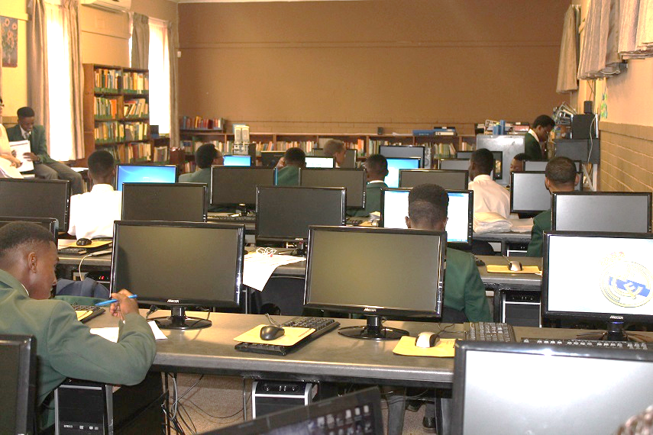
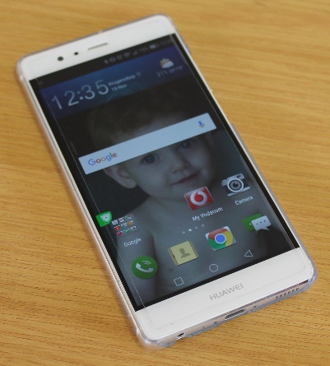
What is a network?
When two or more computers or mobile devices are connected to each other we have a network

Slide 4
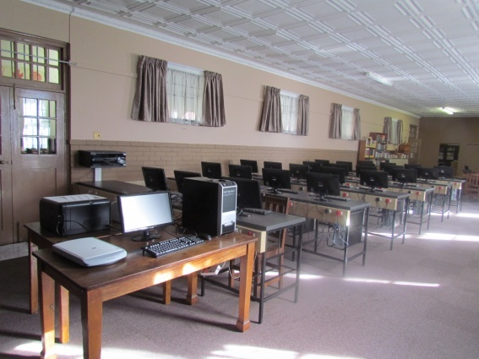
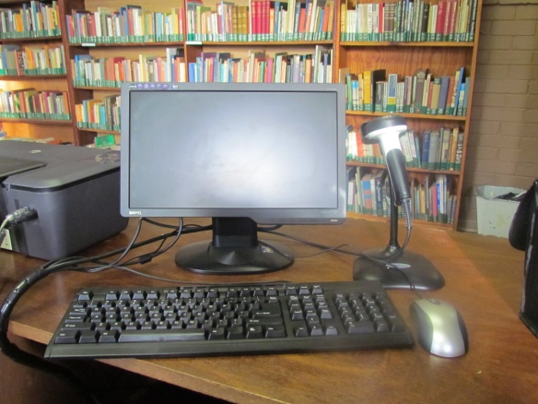
What is a network?
Global Network
internet
Local Area Networks

Slide 5
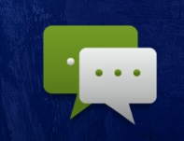
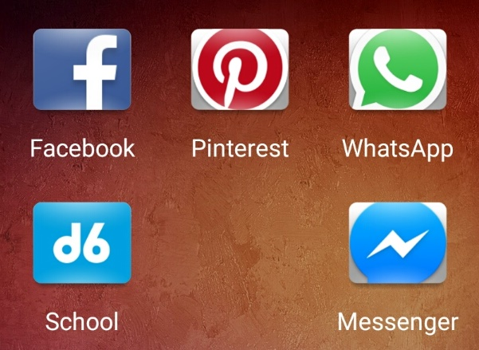
Advantages of networks
Fast, efficient communication
School environment: email / SMS
Instant messages: WhatsApp / BBM / Messenger / WeChat
Social Networks: Facebook / Instagram

Slide 6
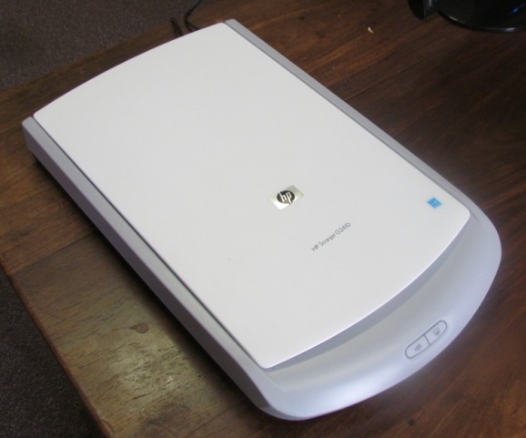
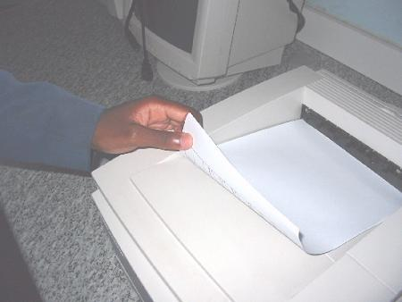
Advantages of networks
Sharing of hardware
Equipment can be shared by users on a network – cheaper than buying a device for each computer.
You can even print from your smartphone to any printer in the world!

Slide 7
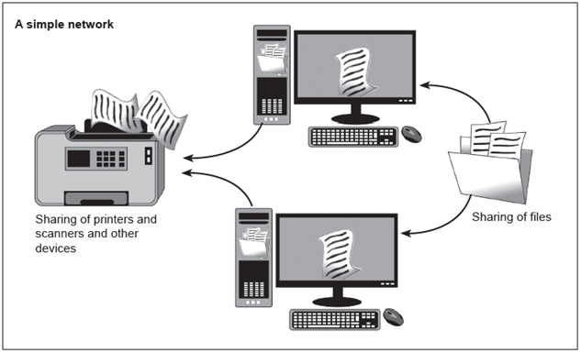


Advantages of networks
Sharing of files
Files on a server can be accessed by learners, and teachers can retrieve learners’ files
Files can be saved in the ‘cloud’ – on a computer connected to the internet

Slide 8
Advantages of networks
Centralisation of data
Networking allows us to access files or folders on a central computer (as if these were actually on our own computer)
Databases ensure that multiple users cannot make conflicting changes to data (while also ensuring that changes made by users are immediately available to other users)
THEATRE TICKET
ADMIT ONE
No two people can book the same seat in a theatre!
THEATRE TICKET
ADMIT ONE

Slide 9



Advantages of networks
Flexible access
We are not limited to the physical location of our computers
Using internet removes location-specific limit of a network
Use cloud storage to save & ‘sync’ files
Internet banking can be done from home

Slide 10
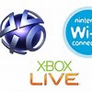





Advantages of networks
Leisure
Radio, video and television can be ‘streamed live’ over the internet
E-books, online newspapers and magazines can be downloaded
Online gaming – play against others around the world (MMORPG)
Notes:
‘LAN parties’ (LANing) are popular activities where people get together and play games on a network. Even though they are called LAN parties, they don't always stop at local area networks, sometimes including people across the world using the internet. LAN competitions have also become popular where teams from different schools compete against one another.

Slide 11
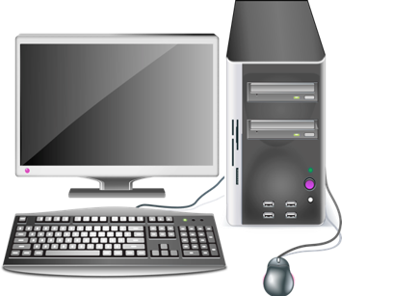
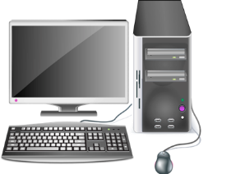
Advantages of networks
Increased control and security
Easier to control access to data
Data centrally stored – easier to make backups
Maintain integrity of data – update in one location
Easier to send updates (e.g. anti-virus software) to all computers from one central computer

Slide 12
Disadvantages of having a network
Learning curve – how to protect your privacy online and how to communicate safely
Can be expensive to set up and maintain
Confidential / sensitive information may be stolen
Harmful software can spread quickly
If network develops a problem, users might not be able to communicate or access data
Central fault in network can cause loss of data

Slide 13
Test and improve
Summary – concepts, terms and tips
Network
Server
Internet
Advantages
Disadvantages

Slide 14
Written module activity
Notes:
Purpose of this exercise:
Testing knowledge of this module.

